Slide 1
Online STI testing service in the Republic of Ireland

Slide 2
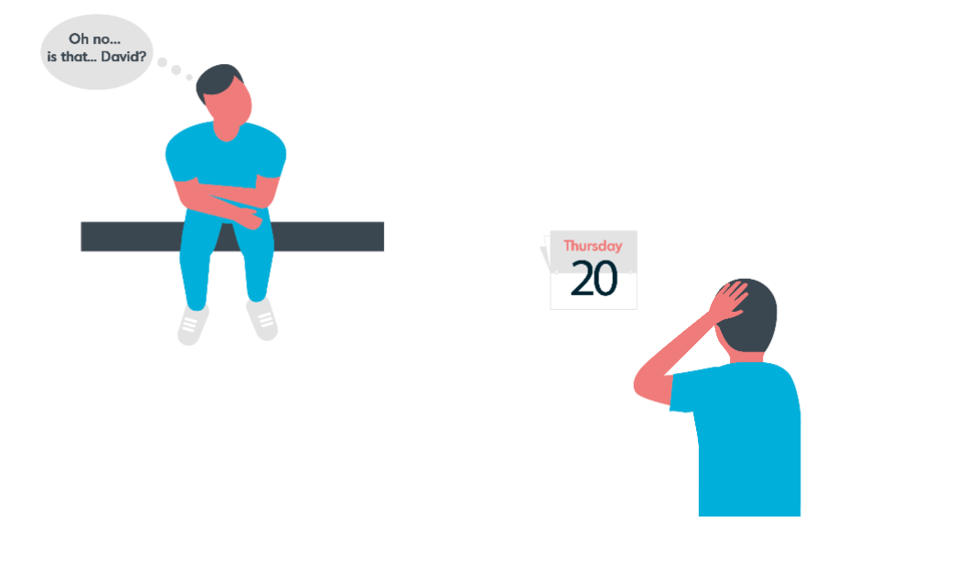
Online sexual health services:
Online sexual health services can allow people to test for sexually transmitted infections (STIs) easily from home. Ordering a kit online, people can complete the samples, returning them by post, and have results quickly and discretely returned to them by text message or phone call.
Online services can help lower some of the barriers which people may face accessing sexual health services, including:
Travelling to a clinic
Taking time off work to attend an appointment
Concerns about discretion (such as bumping into people in a waiting room)
Anxiety waiting for results (online services can return results within 3 days)

Slide 3
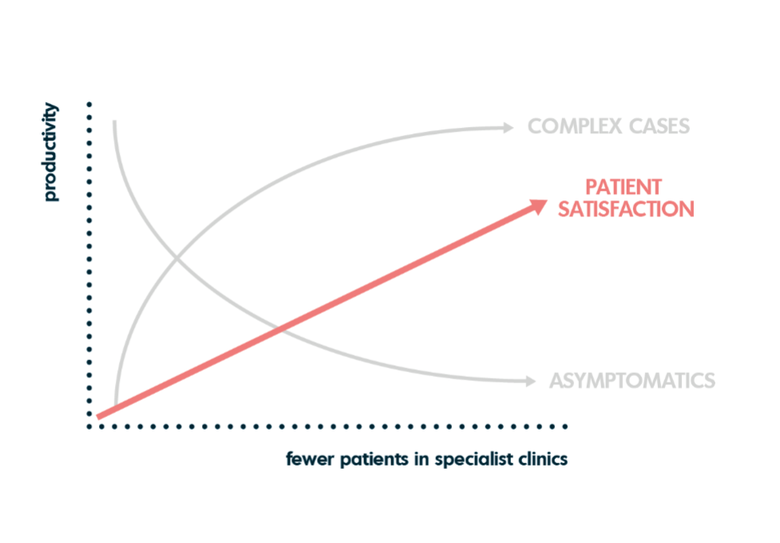
Online sexual health services:
Online services can also help support physical sexual health services, which are under high demand.
Undertaking simple sexual health activity online (like an asymptomatic STI test), means that clinician time can be saved in clinic for supporting people with more complex needs (e.g. those with symptoms, multiple needs or at risk of poor sexual health).

Slide 4
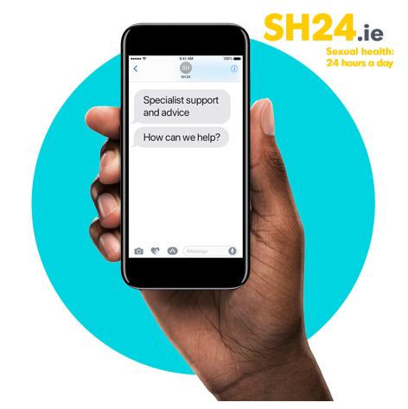
About the home STI testing pilot:
In early 2021, the HSE Sexual Health & Crisis Pregnancy Programme (SHCPP) piloting a home STI testing service for Ireland in partnership with online STI testing provider SH:24.
The aim of the pilot project was to assess the feasibility, acceptability and impact of an online STI service that is integrated with public STI clinics in Ireland.
The objectives of the pilot project were to:
shift those with less complex sexual health needs out of clinics to an online service thus reducing waiting times and more appropriately using available public STI clinic staff resources
improve service user access to STI testing and treatment in the pilot project areas
promote self-management of service users through online access to comprehensive sexual health information, signposting to services and remote clinical support.
The evaluation of the pilot is currently being completed.

Slide 5
This means that anyone from the age of 17 with an address in these counties, can order a free STI test to their home.
Who can access the home STI testing service?
From Tuesday 1st February 2022, home testing is available free of charge to individuals in the following counties:
Cavan
Clare
Cork
Donegal
Dublin
Galway
Kerry
Kildare
Laois
Leitrim
Limerick
Louth
Mayo
Meath
Monaghan
Offaly
Roscommon
Sligo
Tipperary
Wicklow

Slide 6
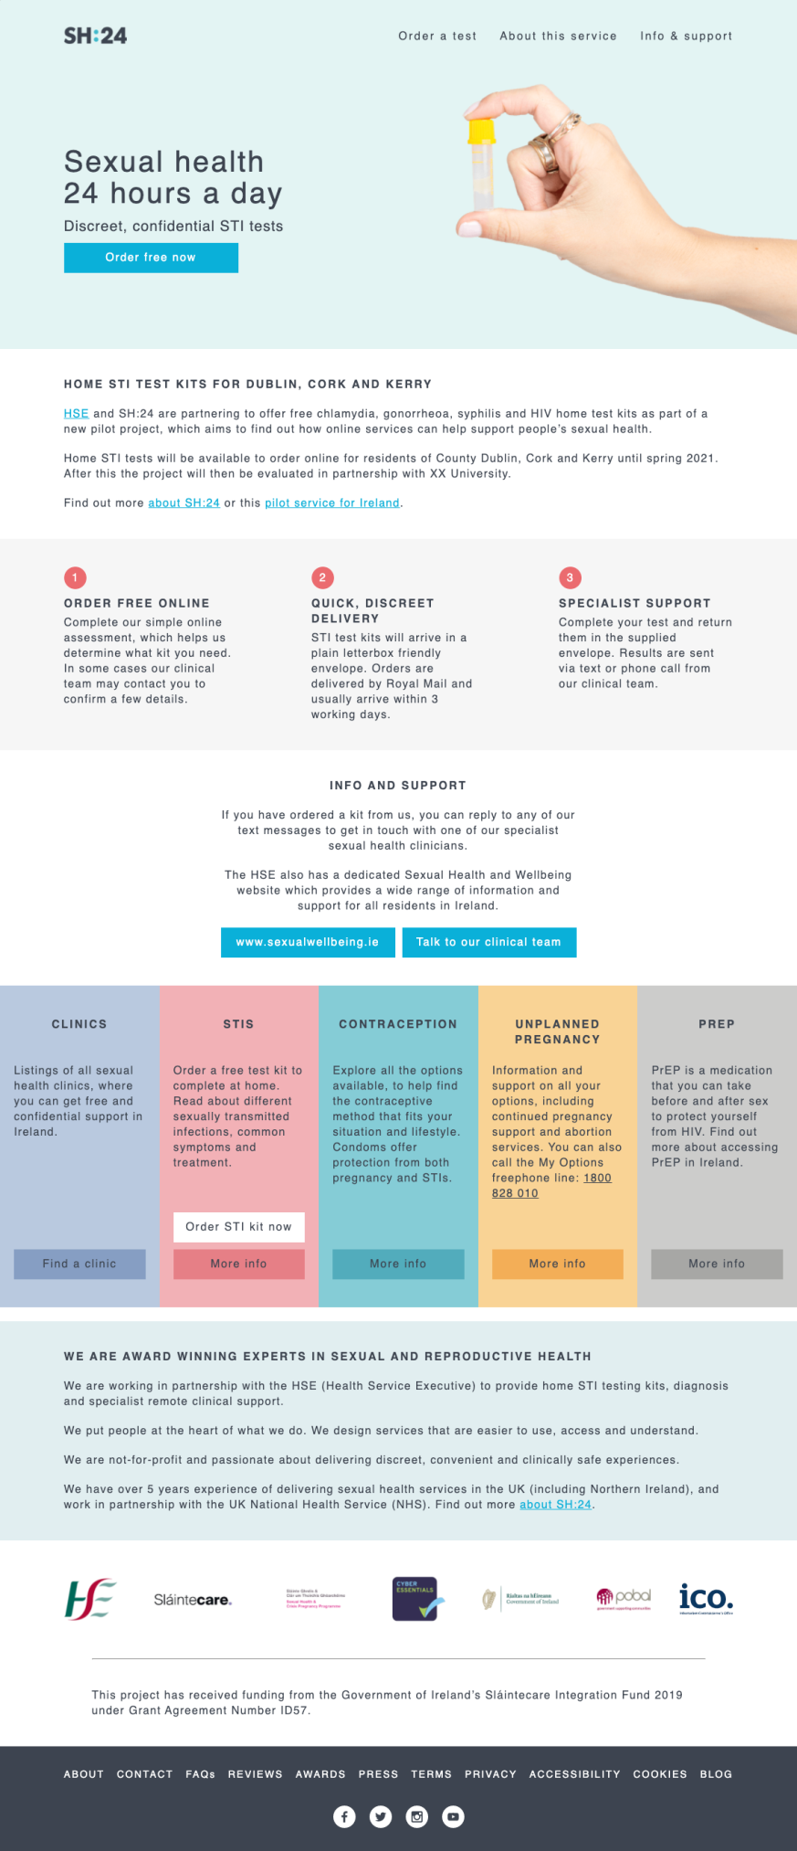
How do people order a home STI test?
Free STI tests can be ordered from SH24.ie
Users will receive a full STI test for HIV, syphilis, chlamydia and gonorrhoea, with hepatitis B and C tests offered as required.
Home STI testing is for individuals who do not have symptoms of an STI.
Anyone who has symptoms of an STI should attend a sexual health service or their GP for assessment.

Slide 7
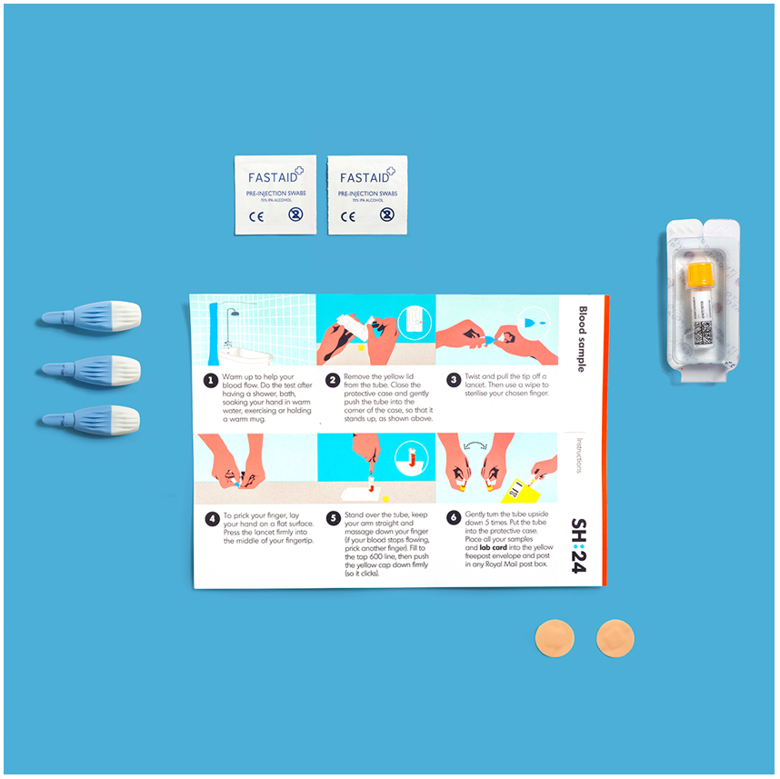
User support:
Users will be supported with simple instructions to complete a blood sample, alongside a vaginal swab or urine sample. Oral and anal swabs may also be required.
Videos are also provided to guide users, alongside clinical support offered by SH:24 clinicians by text message or phone call, 7 days a week.

Slide 8
Returning the kit and results:
Samples are returned in the provided envelope to SH:24’s partner laboratory in Dublin.
Results are returned within 3 days of receipt at the lab, by text message or phone call from an SH:24 clinician.

Slide 9
Getting treatment and support in clinic:
Users who need a confirmation test or to access treatment are supported by our clinical team to access one of our partner clinics in:
GUIDE Clinic, St. James’s Hospital, Dublin
Mater Misericordiae University Hospital (MMUH), Dublin
St. Vincent's University Hospital (SVUH), Dublin
South Infirmary Victoria University Hospital (SIVUH), Cork
Louth County Hospital, Dundalk
Our Lady of Lourdes Hospital, Drogheda
Galway University Hospital
Midland Regional Hospital Portlaoise
Letterkenny University Hospital, Donegal
Sligo University Hospital
University Hospital Limerick
Ennis General Hospital

Slide 10
How can you support the service?
Simply let people know that those living in the relevant counties can order free home STI tests and refer them to the website:
SH24.ie
Links referring to the sh24.ie website from other community and health websites would be a huge support.

Slide 11
Social media resources:
You can also support the project by promoting it on social media and referring people directly to www.sh24.ie We have a range of images for social media posts on the following slides. These can be downloaded here: https://drive.google.com/drive/folders/1etr7HDRIehT3yDkb44cF55z7KtbAYYy4?usp=sharing
Some suggested copy for social media posts are:
“If you live in one of the participating counties, you can now get a free home STI test through an online STI testing service, supported by the HSE. Visit sexualwellbeing.ie or sh24.ie to find out more.”
“Do you live in one of the participating counties? You can now order a free home #STItesting kit at sh24.ie. Supported by the HSE.”
“Haven’t got time to go to the #STI clinic? Residents in participating counties can now get a free STI home test at sh24.ie. Supported by the HSE.”
“You can now test for #STIs for free without going to a clinic if you live in one of the participating counties. Visit sexualwellbeing.ie or sh24.ie for more info. Supported by the HSE. ”
“Don’t have symptoms but want an STI test? Residents in participating counties can now get a free online test at sh24.ie. Supported by the HSE”.
For more support on social media content and approaches, please contact justin@sh24.org.uk

Slide 12
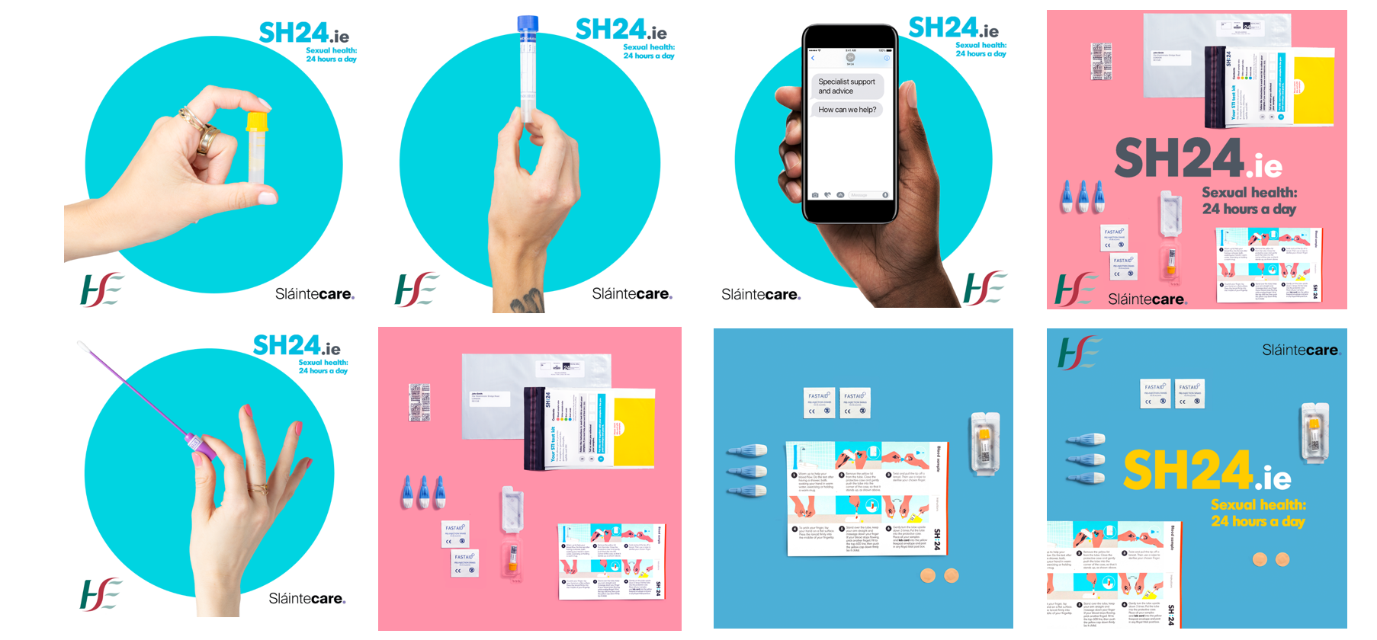
Social media resources 2:
Facebook or Instagram images (1:1 ratio): https://drive.google.com/drive/folders/1etr7HDRIehT3yDkb44cF55z7KtbAYYy4?usp=sharing

Slide 13
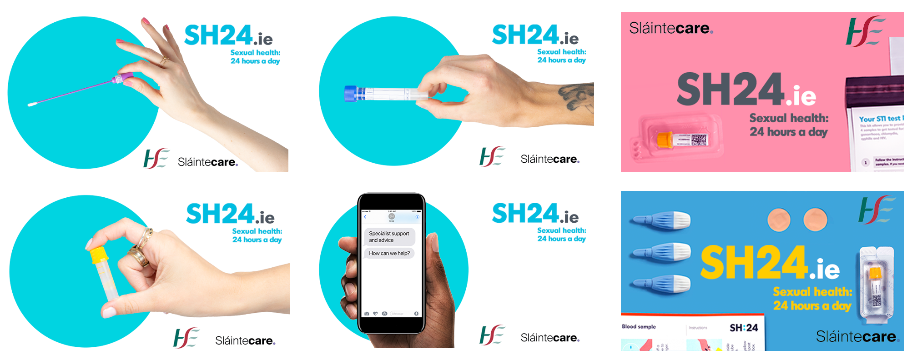
Social media resources 3:
Twitter images (16:9 ratio): https://drive.google.com/drive/folders/1etr7HDRIehT3yDkb44cF55z7KtbAYYy4?usp=sharing

Slide 14
About SH:24:
SH:24 are a Community Interest Company based in the UK. They are a clinically led organisation who brings together medical consultants, nurses, public health experts, designers and developers to create award-winning online sexual health and reproductive services.
SH:24 is registered with the Quality Care Commission in the UK, and the Regulation and Quality Improvement Authority in Northern Ireland. They work in partnership with the UK’s National Health Service in over 35 areas, and also run similar projects in Germany, Romania and Kenya.
SH:24 currently support over 450,000 people each year to test for STIs, and have an overall customer rating of 4.9 out of 5.
You can find out more about SH:24 here: https://sh24.org.uk/about-sh24

Slide 15
Contact details:
For information or any queries about the service, please contact:
HSE Sexual Health & Crisis Pregnancy Programme
Caroline Hurley, Project Manager
caroline.hurley1@hse.ie
SH:24
Justin Harbottle, Project Lead
justin@sh24.org.uk

