Slide 1

Making Every Contact Count Programme
Sandra Coughlan, Health and Wellbeing

Slide 2


Making Every Contact Count (MECC)
A health behaviour change programme for the health services
Aim of webinar:
To provide an overview of the MECC Programme
To provide information on the MECC eLearning Course and the MECC Workshop
Objectives: Following attendance at the webinar, participants will
Have an increased understanding of the MECC programme
Understand the importance of behaviour change in reducing chronic disease
Understand the role General Practice Nurses can play in Making Every Contact Count
Understand how to access the MECC eLearning Course and the Workshop

Slide 3
First, some questions about MECC
Were you aware of the MECC programme before this webinar was arranged?
Do you talk to your patients about any of the following -eating healthily, giving up smoking, drinking less or doing some exercise?

Slide 4
MECC Programme
MECC is about chronic disease prevention
The MECC approach enables healthcare professionals to engage people in conversations about improving their health by addressing risk factors such as diet, physical activity, alcohol and tobacco
MECC enables the opportunistic delivery of consistent and concise healthy lifestyle information
MECC uses brief interventions, delivered whenever the opportunity arises in routine appointments and contacts

Slide 5
Video 1 - Overview of programme

Slide 6
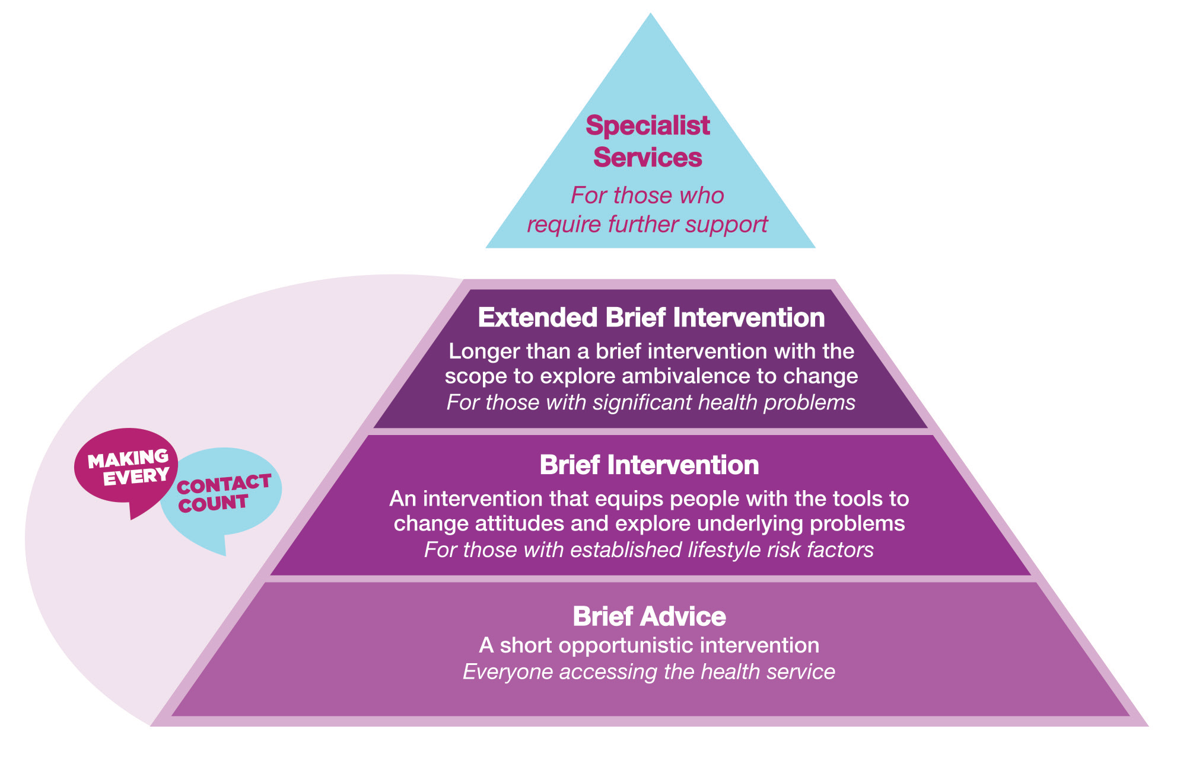
Making Every Contact Count Model
The training programme will equip staff to conduct brief interventions with their patients.
A brief intervention is a short interaction between a healthcare professional and their patient, designed to help motivate and support that person to make a change in their lifestyle behaviour.

Slide 7
What does MECC mean for...
Organisations - MECC means providing their staff with the leadership, environment, training and information that they need to deliver the MECC approach
Staff - MECC means having the competence and confidence to deliver healthy lifestyle messages, to help encourage people to change their behaviour and to direct them to local services that can support them
Individuals - MECC means seeking support and taking action to improve their own lifestyle by eating well, maintaining a healthy weight, drinking alcohol sensibly, exercising regularly, not smoking and looking after their wellbeing and mental health

Slide 8

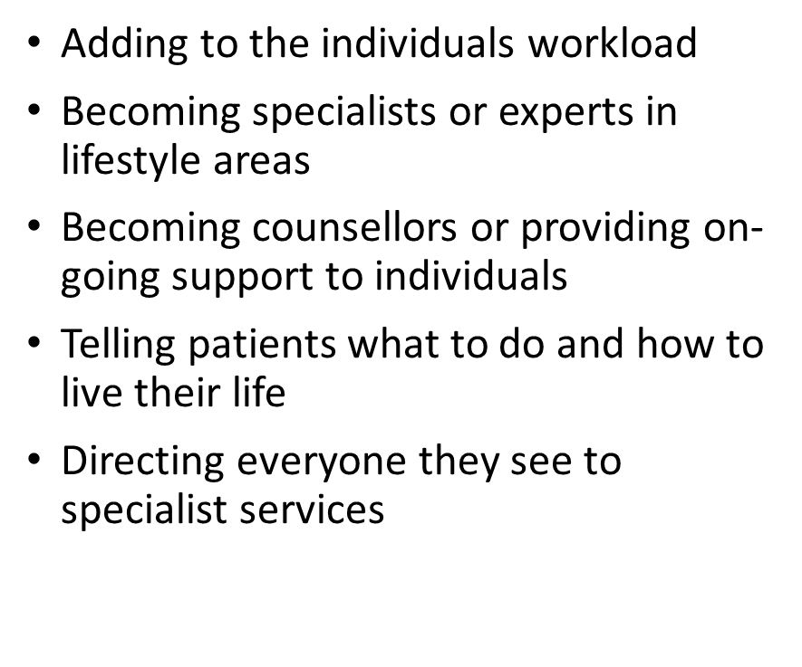
Making Every Contact Count is ….
Healthcare professionals having brief conversations with their patients about behaviour change
Being aware of the supports that are available in the community to help people to make changes
Patients expecting their healthcare professional to ask them about their lifestyle behaviour
Patients knowing that they can get support from their healthcare professional about their lifestyle behaviour change.

Slide 9








Key Strategic and Policy Drivers

Slide 10
MECC & General Practice Nurses
Unique opportunity with all patient consultations
14 million contacts each year with GP services (GP and Practice Nurses)
MECC is part of the GP Contract for Chronic Disease Management Programme for GMS/GPVC patients
Risk Factors assessed and health behaviour change intervention carried out

Slide 11
Video 2 - A Brief Intervention in action - GP

Slide 12
General Practice Nurse perspective
Handover to Gillian

Slide 13
Training for Healthcare Professionals
learning.makingeverycontactcount.ie

Slide 14





MECC eLearning Course
Before you Start
Short pre-course self assessment of knowledge and current practice
Introduction to Behaviour Change
Foundation of the training; describes the approach and skills needed to conduct a brief intervention; recognising the opportunities to raise the issue of change
Four Lifestyle Topics
   Tobacco Free  Alcohol and Drug Use
   Get Ireland Active  Healthy Food for Life
Each module
30 mins
Skills into Practice
Demonstrates the brief intervention skills in practice through the use of short videos; the learner observes and critiques what is used and reflects on their own practice
Post Course Assessment
To be attempted only when all the online modules have been completed.
Need 70% to pass and get your certificate. Can attempt it any number of times

Slide 15
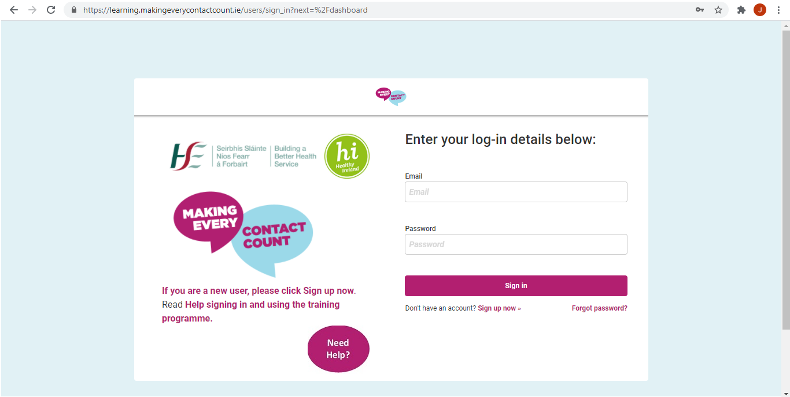
Sign up and registration
Training is available on
learning.makingeverycontactcount.ie
Technical Requirements:
  Internet Explorer Version 10
  Google Chrome
Need Help – click here for User Guide

Slide 16
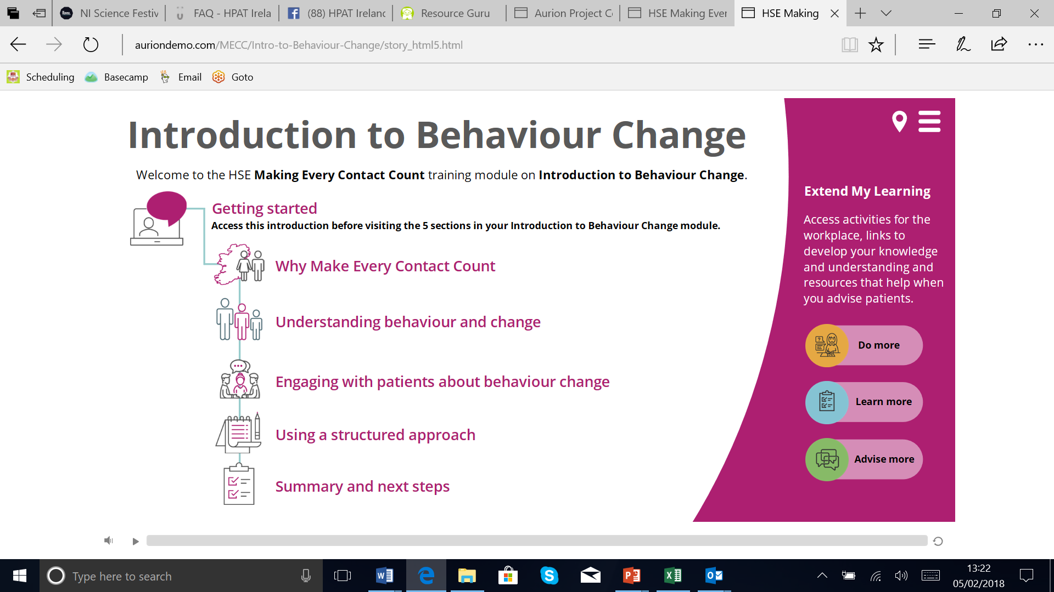

Slide 17
Some more questions –
(Healthy Ireland Survey 2019)
What % of the population are current smokers?
What % of the population meet the minimum amount of activity recommended by the National Guidelines on Physical Activity for Ireland?

Slide 18
Elements of a brief intervention
Getting off to a good start – meet and greet to build rapport
Guiding the consultation: 5 As Framework
  Ask - About the behaviour
  Advise – On the need for behaviour change
  Assess – Readiness to change
  Assist - With
    exploring the benefits and barriers of change
    Identifying options to change
    Goal setting
  Arrange – signpost or refer to additional support if appropriate
End the consultation – with clear succinct summary of what is agreed

Slide 19
Signposting to supports & resources
What % of the population are current smokers?
What % of the population meet the minimum amount of activity recommended by the National Guidelines on Physical Activity for Ireland?

Slide 20
Signposting to Smoking Supports
www.quit.ie has information to support patients who are thinking about quitting.
Free helpline: 1800 201 203
Email support: support@quit.ie
Free text support: text QUIT to 50100.
Facebook: facebook.com/HSEquit.
Twitter: @HSEQuitTeam.
‘One-to-one’ support: Smoking Cessation clinics.
Notes:
We’ll get started first by asking some questions
17% of the population are
46% are achieving the minimum level of activity recommended by the National Guidelines by being moderately active for at least 150 minutes a week.
I’m going to ask Bill to set this up
I might add to this & say or before Theresa published an article in the Nursing magazine in May this year.
So had you heard about MECC? Please let us know how you heard about MECC by typing in to the chat box.
So, looks like the majority of you have these conversations with your patients. The good news is that you are already doing MECC. You are making every contact count. You may not know the name but you will most likely know what’s involved with having these conversations
So this brings us to the question…. . ‘What is MECC?’

Slide 21
Signposting to Physical Activity Supports
https://www2.hse.ie/healthy-eating-active-living/exercise/
Local Sports Partnership
https://www.sportireland.ie/participation/lsp-contact-finder
Walking clubs https://www.getirelandwalking.ie/
Parkrun - local Saturday morning parkrun https://www.parkrun.ie/
Fit4Life - https://www.fit4life.ie/
Notes:
We’ll get started first by asking some questions
17% of the population are
46% are achieving the minimum level of activity recommended by the National Guidelines by being moderately active for at least 150 minutes a week.
I’m going to ask Bill to set this up
I might add to this & say or before Theresa published an article in the Nursing magazine in May this year.
So had you heard about MECC? Please let us know how you heard about MECC by typing in to the chat box.
So, looks like the majority of you have these conversations with your patients. The good news is that you are already doing MECC. You are making every contact count. You may not know the name but you will most likely know what’s involved with having these conversations
So this brings us to the question…. . ‘What is MECC?’

Slide 22
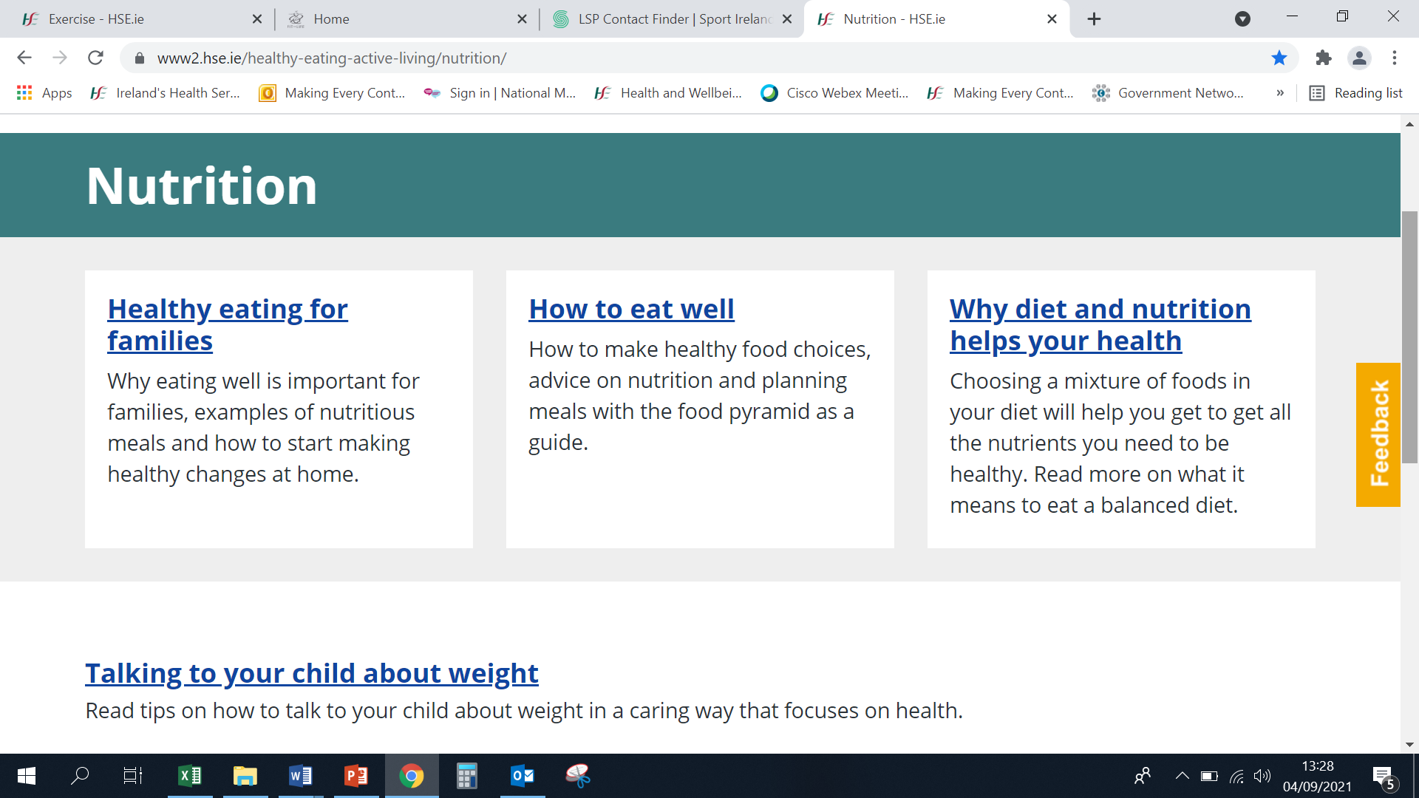
Signposting to Healthy Eating Supports
Check out the Healthy Food for Life resources on the HSE website
https://www2.hse.ie/healthy-eating-active-living/nutrition/
Be aware of local initiatives that your patients may find helpful
e.g. https://www.hse.ie/communitycooking
For those who want to lose weight, signpost them to
local community based weight management support
groups.
Notes:
We’ll get started first by asking some questions
17% of the population are
46% are achieving the minimum level of activity recommended by the National Guidelines by being moderately active for at least 150 minutes a week.
I’m going to ask Bill to set this up
I might add to this & say or before Theresa published an article in the Nursing magazine in May this year.
So had you heard about MECC? Please let us know how you heard about MECC by typing in to the chat box.
So, looks like the majority of you have these conversations with your patients. The good news is that you are already doing MECC. You are making every contact count. You may not know the name but you will most likely know what’s involved with having these conversations
So this brings us to the question…. . ‘What is MECC?’

Slide 23
Signposting to Alcohol Supports
www.askaboutalcohol.ie
provides a one stop shop for information and supports to help patients cut down and maintain low risk drinking behaviours.
www.drugs.ie provides a one stop shop for information and supports to help patients that are taking drugs.
The HSE runs a confidential alcohol & drugs helpline
1800 459 459

Slide 24
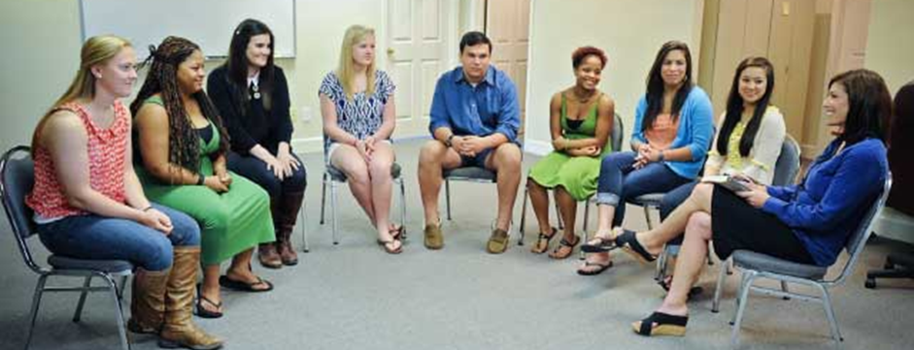
Enhancing your Brief Interventions
When participants have completed the eLearning course, they are eligible to enrol for the face to face/virtual workshop called ‘Enhancing your Brief Intervention Skills’
The emphasis of this will be on skills development and sharing of the experience of carrying out brief interventions since completion of the eLearning
½ day duration

Slide 25
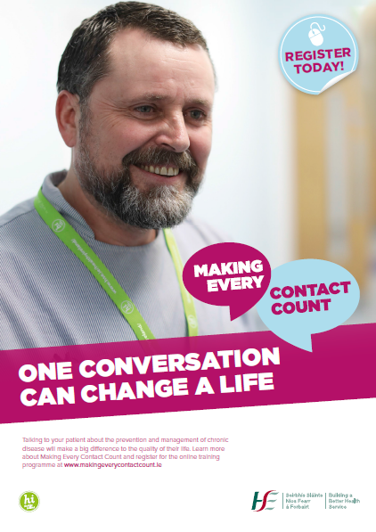



Promoting MECC
Posters – Colleague Focussed
Leaflet

Slide 26
Video 3 - A Brief Intervention in Action – General Practice Nurse

Slide 27
What’s in it for me?
Making Every Contact Count eLearning is:
Easy to complete in 3-4 hours
Free to all healthcare professionals
Recognised for Continuous Professional Development (CPD) by a range of professional bodies including the NMBI
You may have conversations about your own health
Develop the competence and confidence to deliver healthy lifestyle messages
Provides a unique opportunity for you to support your patients in changing their lifestyle behaviours.
Enhancing Your Skills Workshop

Slide 28
In summary– we are asking for your help to integrate MECC into routine clinical practice
Making Every Contact Count is an approach to behaviour change
To reduce chronic disease
By making healthier lifestyle choices
Part of routine clinical practice for all healthcare professionals
Millions of contacts - opportunities to have conversations
Delivering concise consistent healthy lifestyle messages
Support & empower patients
Client centred approach
National standardised training
Brief interventions only take a few minutes
Evidenced based

Slide 29
Thank you for your attention
Email: makingevery.contactcount.ie
Further information on
MECC Website – learning.makingeverycontactcount.ie
HSE Website – makingeverycontactcount.ie
Resources available at – healthpromotion.ie

